Slide 1


Azure SQL for Beginners Introduction to Performance Troubleshooting
Special Edition
#azuresql
aka.ms/azuresql4beginners

Slide 2


Azure SQL for Beginners
Module 1 Introduction to Azure SQL
Module 2 Deploy and configure
Module 3 Security
Module 4
Performance
Module 5
Availability
Module 6
Putting it all together
aka.ms/azuresql4beginners
aka.ms/azuresqlfundamentals

Slide 3

Azure SQL for Beginners Special Edition Performance Troubleshooting
Why Special Edition on Performance Troubleshooting?
Focus is on Azure SQL Database
Try it yourself at aka.ms/azuresqlworkshop

Slide 4


Performance is “slow” = Running vs Waiting
Low or
no CPU
High CPU
What queries are the top resource consuming queries or are waiting?

Slide 5
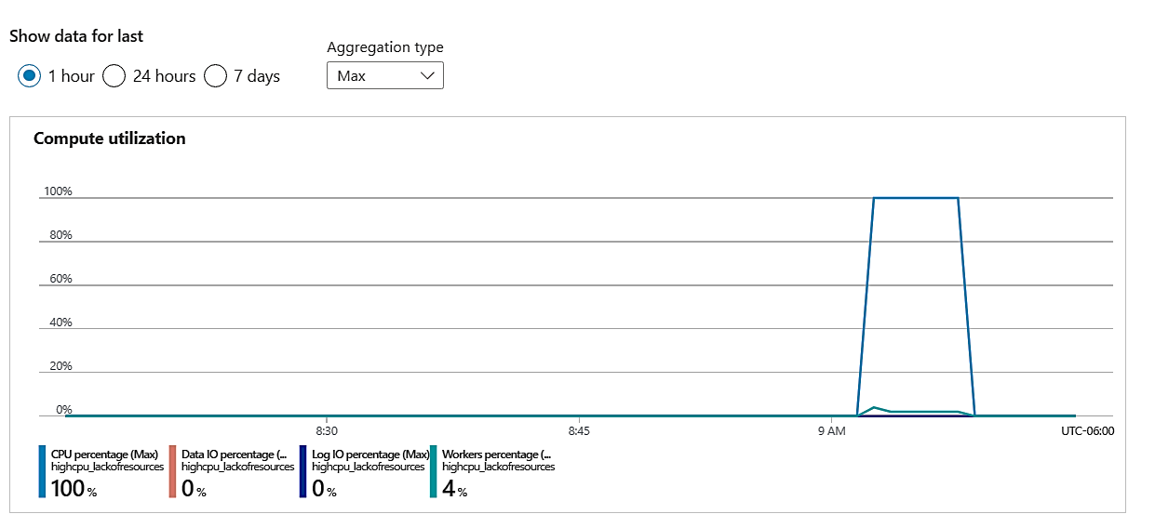
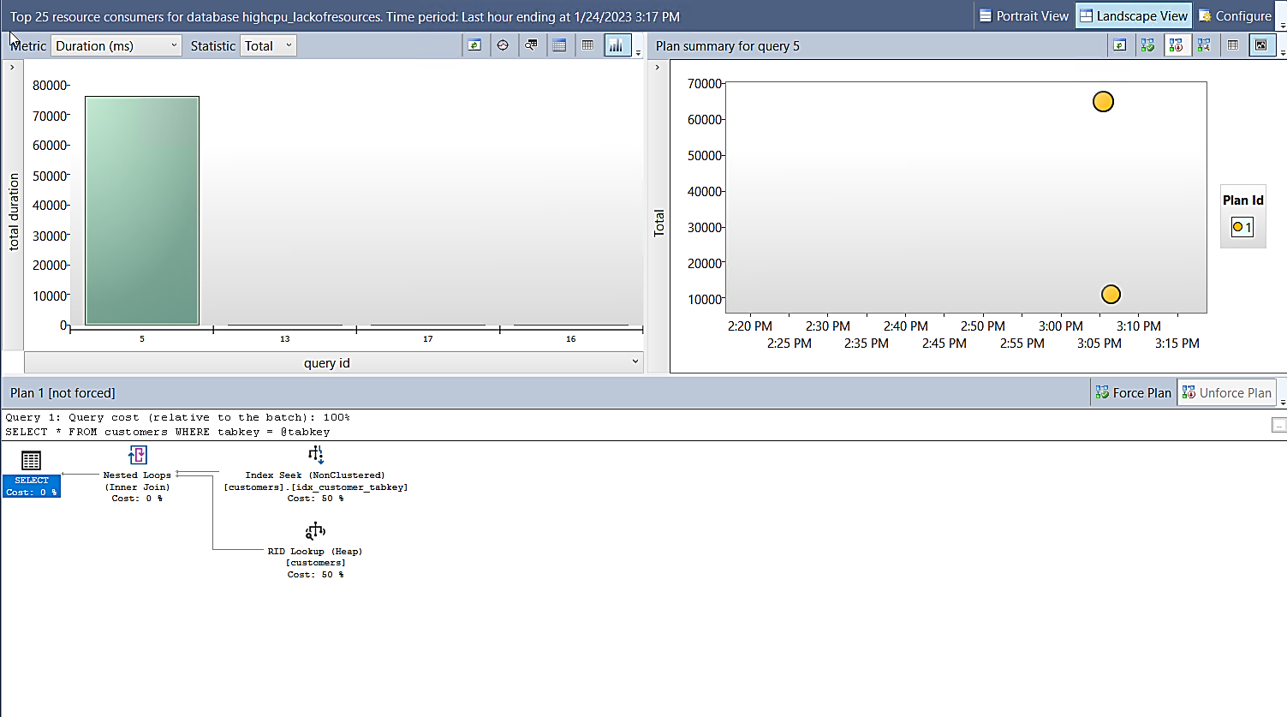
Where do you start?
Azure Portal
Compute Utilization
Query Store

Slide 6



Running vs Waiting Scenarios
High CPU
Waiting
Missing Index
Blocking
Anti-pattern queries
Deadlocks
Lack of resources
Memory Grants

Slide 7
Tools you will use
Azure Portal
Azure Metrics and Diagnostics
SQL Server Management Studio (SSMS)
Query Store
T-SQL and Dynamic Management Views (DMV)

Slide 8
Summary
SQL performance problems are either running or waiting.
SQL performance problems typically involve finding out what queries are involved.
Azure SQL Database performance problems start with the Azure portal metrics and the Query Store.
Running or waiting problems involve high CPU or blocking scenarios.
You have various tools to help you diagnose and solve Azure SQL Database performance problems.

Slide 9
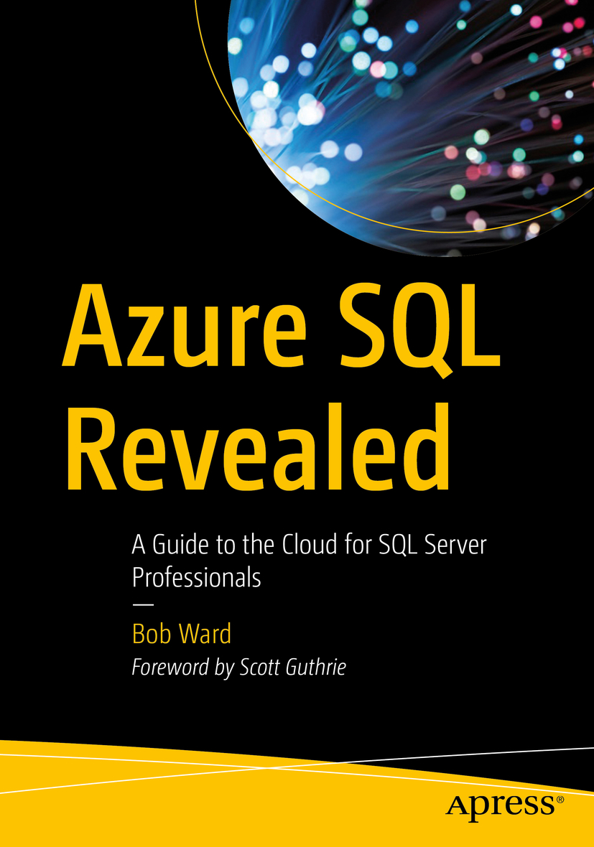

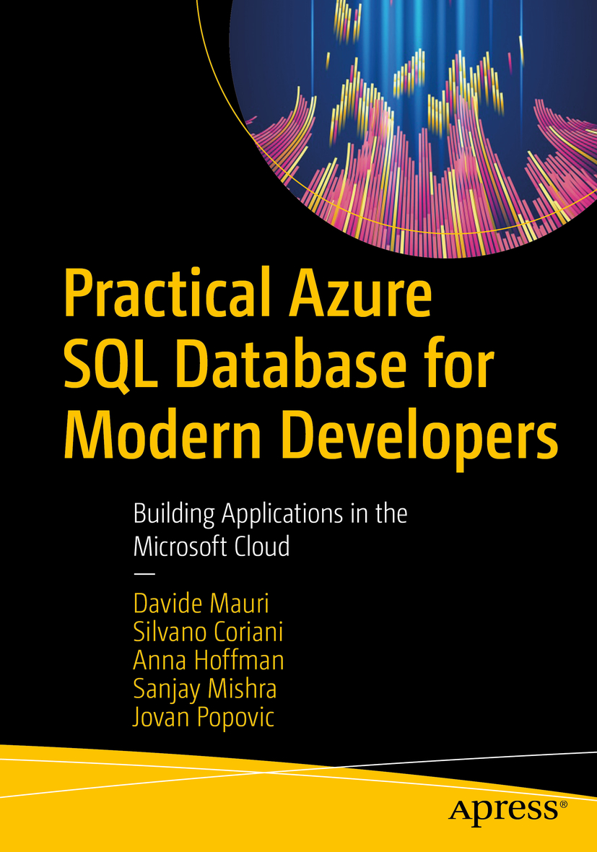


Learn more
Troubleshoot Azure SQL Performance
aka.ms/fixazuresqlperf
Azure SQL for Beginners
aka.ms/azuresql4beginners
Azure SQL Workshop
aka.ms/azuresqlworkshop
Module 7
Performance Troubleshooting
^{New}
aka.ms/azuresqlbook
Azure SQL Fundamentals
aka.ms/azuresqlfundamentals
Watch Data Exposed
aka.ms/dataexposed
See more videos from our team
aka.ms/azuresqlyt
Follow us on social media
aka.ms/azuresqltwitter
aka.ms/azuresqlfordevelopers

